Slide 1
Activity 1.5 - Route Finding Tree Diagram
Teacher implementation notes:
This slide deck is meant to be a drag and drop tool to assist students with creating their route finding search tree diagram.
This can be used in conjunction with any completed map diagram. All nodes should be labeled/assigned to a level on the map prior to using this.
Students will type the name of a node in the provided box and drag it to the correct level. Lines will be added to link each node to its parent.
Once the route that reaches the destination is found, they will change the links of the correct route to red.

Slide 2
Activity 1.5 - Route Finding Tree Diagram
Complete these steps on the slide on the next page:
Click on the black outline box and type the name of the level 0 node into the box.
Drag the node that you created to the correct level from your map.
Repeat this process for each colored node in the next level from your map.
Click on the line tool and select the arrow. Use these arrows to represent the links between your nodes.
Repeat steps 3 and 4 until you have reached your goal. Turn the links that make the correct route red. Start with your goal node and work your way to your level 0 node.
Notes:
Tom: looks like we need to have the instructions side-by-side with the diagram

Slide 3
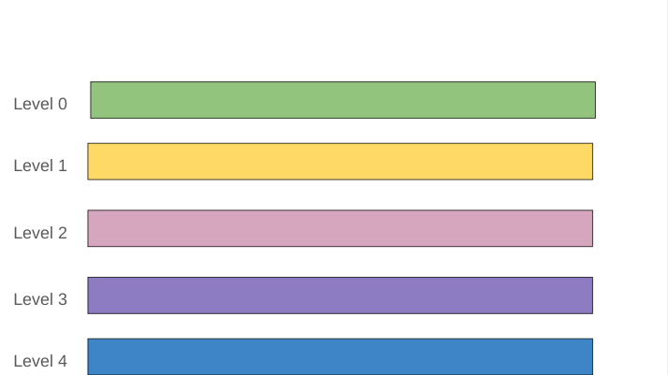
Double click on the outline box to the right to get started

Slide 4
Double click on the outline box to the right to get started
# of nodes
?
?
?
?
?
HI
NT
Notes:
Scaffolding: Under the black and white HINT box, you can edit the number of nodes (in this case cities) you expect students to write. This allows students to do a self-check when they have completed it. The nodes currently have “?” instead of numbers. If you do not want to give students the hints, you can delete the hint box before giving the assignment to students.

